Slide 1

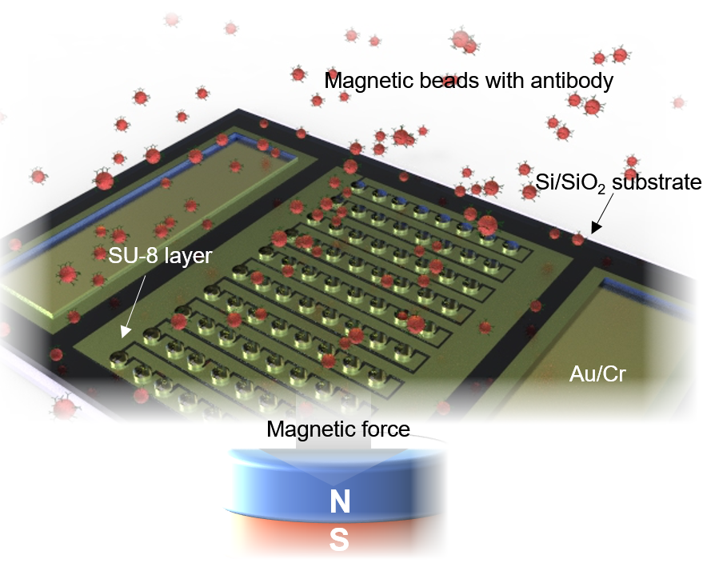
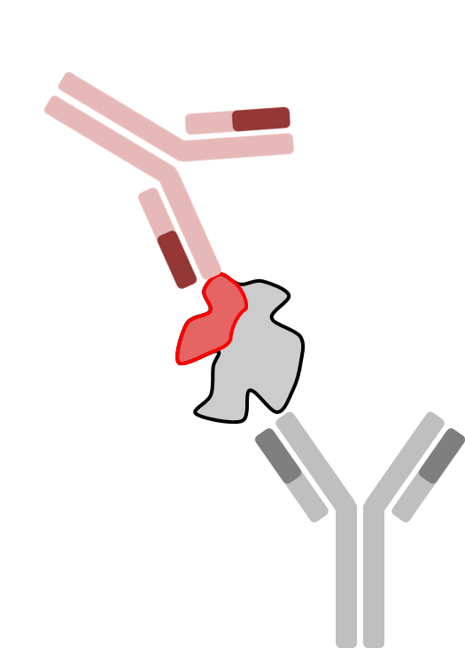
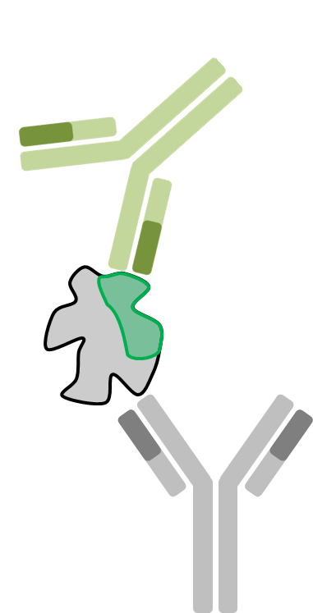
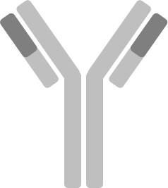
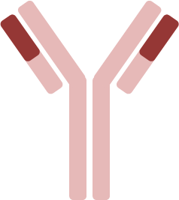




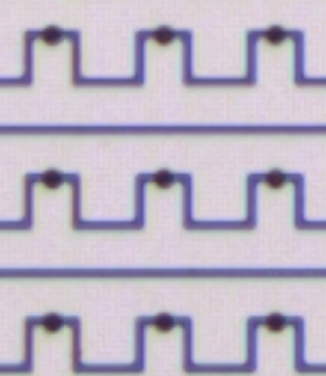
Investigation of tau post-translational modification
based on T217 and T231 in human plasma as new biomarkers
P2-06 (P2-234)
Hyosang Yoon¹, SunSang Kwon¹, Seongeun Jeong¹, Han-Kyeol Kim², Hanna Cho², and Soo Hyun Lee^{1,*}
¹ Korea Institute of Science and Technology, Seoul, Korea, Republic of (South)
² Gangnam Severance Hospital, Yonsei University College of Medicine, Seoul, Korea, Republic of (South)
The correlation between Taumeters for T217 and T231, amyloid-PET SUVR, MMSE score, and CDR-SB score was investigated. A total 43 participants (normal control (n=15), mild cognitive impairment (n=14), and Alzheimer’s disease (n=14)) were investigated. As a result. Taumeter for T217 indicates more strong correlation with analytical results of amyloid-PET SUVR, MMSE score, and CDR-SB score than Taumeter for T231.
Introduction
Methods
Results
Conclusions
Post-translational modification (PTM) of human tau protein is of high importance as an indicator for predicting the progress of Alzheimer’s disease (AD).
Particularly, phosphorylation and O-glycosylation on tau have been observed at relatively high levels in Alzheimer’s disease (AD) patients and healthy controls, respectively.
Recently, a study reported that an increase in the level of phosphorylation at T217 and T231 was observed in the initial stages of the preclinical Alzheimer’s continuum.
To investigate the PTM of tau protein in human blood plasma, an electrochemical sensor with 1μm gap between working and counter electrodes was performed and obtained Taumeter indicating the ratio of phosphorylation and O-glycosylation on the surface of tau protein, where antibodies for phosphorylated T217 and T231 were used.
To explore the clinical association, standardized uptake value ratio (SUVR) of amyloid-positron emission tomography (PET), mini-mental state examination (MMSE), and clinical dementia rating scale sum of boxes (CDR-SB) were also investigated and compared to Taumeters.
A total of 43 participants (normal control (NC, n=15), mild cognitive impairment (MCI, n=14),and AD (n=14) were investigated.
Taumeters for T217 (p=0.00423, AUC=0.82667) and T231(p=0.00034, AUC=0.86222) were obtained and analyzed through one-way analysis of variance (ANOVA) between NC and AD groups.
In regression analysis, Taumeter for T217 (r=0.23824, p=0.12394) was more correlated with amyloid-PET SUVR than Taumeter for T231 (r=0.28072, p=0.06824).
Taumeter for T217 (r=-0.51246, p=0.00044) was also more correlated with MMSE score than Taumeter for T231 (r=-0.07186, p=0.64701).
Taumeter for T217(r=0.57937, p<0.0001) was more correlated with the CDR-SB score than Taumeter for T231 (r=0.16254, p=0.29768).
In this study, we investigated the correlation between Taumeters for T217 and T231, amyloid-PET SUVR, MMSE score, and CDR-SB score.
As a result, Taumeter for T217 indicates more strong correlation with analytical results of amyloid-PET SUVR, MMSE score, and CDR-SB score than Taumter for T231.
r = -0.51246
p = 0.00044
r = -0.07186
p = 0.64701
p = 0.00423
p = 0.00034
Contact
AUC = 0.82667
AUC = 0.86222
References
Soo Hyun Lee* :
shleekist@kist.re.kr
C. Alquezar et al. Frontiers in Neurology, 11 (2021) 595532
Marc Suárez-Calvet et al. EMBO Molecular Medicine, 12 (2020) e12921
Yoon et al. Alzheimer's & Dementia, 18 (2022) e061465
a
b
Primary antibody
r = 0.57937
p < 0.0001
r = 0.16254
p = 0.29768
Secondary antibody (phosphor-tau)
Acknowledgement
Secondary antibody
(O-glycosylated tau)
Human tau protein
r = 0.23824
p = 0.12394
r = 0.28072
p = 0.06824
This research is partially funded by the Brain Research Program through the National Research Foundation of Korea (NRF-2018M3C7A1056896) and the Korea Health Technology R&D Project through the Korea Health Industry Development Institute (KHIDI) and Korea Dementia Research Center (KDRC), funded by the Ministry of Health & Welfare and Ministry of Science and ICT, Republic of Korea (grant number : HU20C0164) and supported by KIST Internal program (2E31521).
O-glycosylated tau
Phosphorylated tau
c
Impedance change
d
e
Bead
SU-8
Impedance decrease
Cr/Au
Si/SiO2
Under 1 μm

