Slide 1
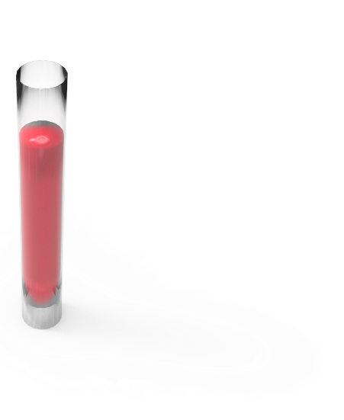
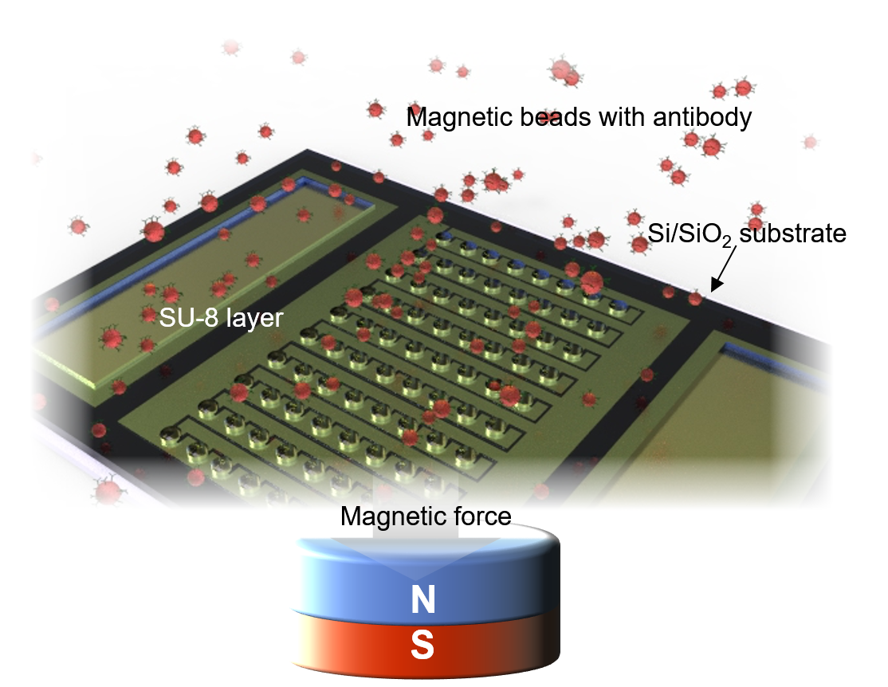
Classification of human tauopathy using blood:
Detection of tau isoforms in patients’ blood with a magnetic bead-based gap sensor
P1-276
SunSang Kwon¹, Mijin Yun², and Soo Hyun Lee^{1,*}
¹ Brain Science Institute, Korea Institute of Science and Technology, Seoul, Korea
² Yonsei University College of Medicine, Seoul, Korea
A novel magnetic bead-based gap sensor detected and compared tau isoforms in blood samples collected from living patients. For analysis using blood, the impedance change rates of 3R- and 4R-tau were measured, and their respective ratios were calculated. As a result, it is expected to be able to differentiate healthy control group from Alzheimer’s disease and 4R-tau dominant tauopathy patient groups by measuring the tau isoforms in the blood.
Introduction
Methods
Results
Conclusions
References
Tau protein, deposited or phosphorylated in the brains of patients with neurodegenerative progression, has six isoforms that include or exclude N-terminal exons 2 and 3 and Exon 10, a microtubule binding region.
Especially, 3R- and 4R-tau, which are distinguished by the inclusion or exclusion of exon 10, are known to be balanced in normal adults.
However, in case of tauopathy such as progressive supranuclear palsy, the balance is disrupted, and 4R-tau becomes dominant in the patient’s brain.
In this regard, some tauopathies can be classified through a comparison of tau isoforms in the blood or cerebrospinal fluid (CSF) of neurodegenerative patients.
First, magnetic beads were coated with each antibody that specifically interact with 3R- or 4R-tau protein, respectively.
The prepared samples were reacted with the patient’s blood samples from 1) healthy control (HC), 2) Alzheimer’s disease (AD), and 3) 4R-tau dominant tauopathy (4RDT).
Samples incubated with 3R- and 4R-tau antibodies, respectively, were placed between two metal electrode arrays surrounded by the SU-8 well structure, and their impedance changes were measured by the electrochemical method.
In the case of HC and AD, 3R- and 4R-tau are known to be in balance, but as a result of measuring the impedance change rate of HC, it was found that the impedance change rate of 4R-tau is larger than that of 3R-tau.
Especially for the 4R-tau, HC group exhibits a larger impedance change rate than the AD and 4RDT groups.
The 4RDT group had a large impedance change rate of 4R-tau in blood, whereas the impedance change rate of 3R-tau was much lower than that of 4R-tau and other HC and AD groups.
We used a magnetic bead-based gap sensor to detect/compare tau isoforms in blood samples collected from living patients.
Although slightly different from the expectation, the HC group showed a larger impedance change rate of 4R-tau than the AD and 4RDT groups.
In case of HC group, the measured results of 4R-tau were relatively higher than that of 3R-tau.
On the other hand, in the AD group, the measured results of 3R-tau were similar to or slightly higher than those of 4R-tau.
The 4RDT group showed similar results to the HC group, but the difference between 3R- and 4R-tau impedance change rates was much larger than that of the HC group.
As a result, it is expected to be able to differentiate HC from AD and 4RDT by measuring the tau isoforms in the blood.
Kidd, Paired helical filaments in electron microscopy of Alzheimer’s disease, Nature, 197, 192-193 (1963)
Goedert et al., Multiple isoforms of human microtubule-associated protein tau: sequences and localization in neurofibrillary tangles of Alzheimer's disease, Neuron, 3, 519-526 (1989)
Hara et al., Isoform transition from four-repeat to three-repeat tau underlies dendrosomatic and regional progression of neurofibrillary pathology, Acta Neuropathol., 125, 565-579 (2013)
Acknowledgement
This research is partially funded by the Brain Research Program through the National Research Foundation of Korea (NRF-2018M3C7A1056896) and the Korea Health Technology R&D Project through the Korea Health Industry Development Institute (KHIDI) and Korea Dementia Research Center (KDRC), funded by the Ministry of Health & Welfare and Ministry of Science and ICT, Republic of Korea (grant number : HU20C0164) and supported by KIST Internal program (2E31521).
Blood
Contact
Impedance
change
Soo Hyun Lee* :
shleekist@kist.re.kr
3R- or 4R-tau antibody
Tau protein
(in human blood)
Magnetic bead
Au metal electrode
Healthy
control
(HC)
Alzheimer’s
disease
(AD)
4R-tau
dominant tauopathy
(4RDT)

