Slide 1
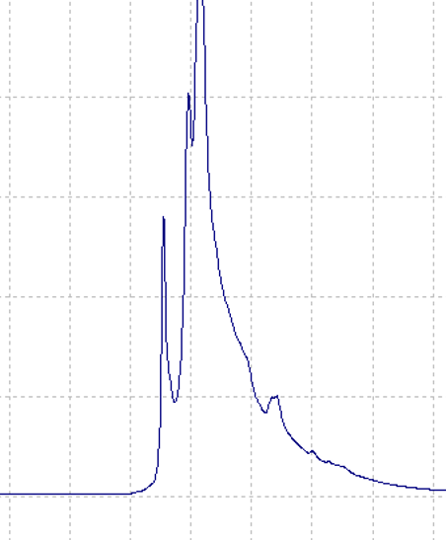
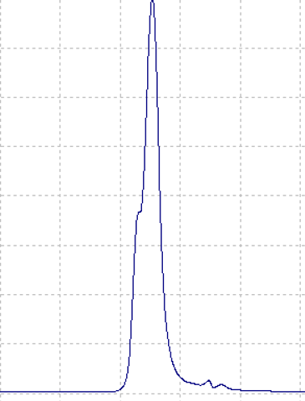
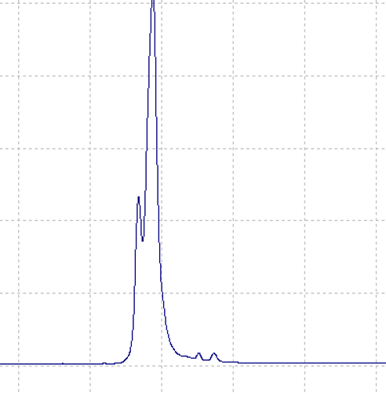
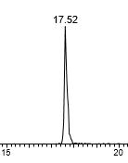
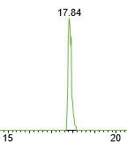
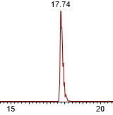
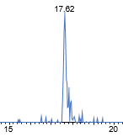
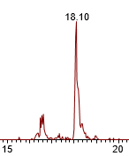
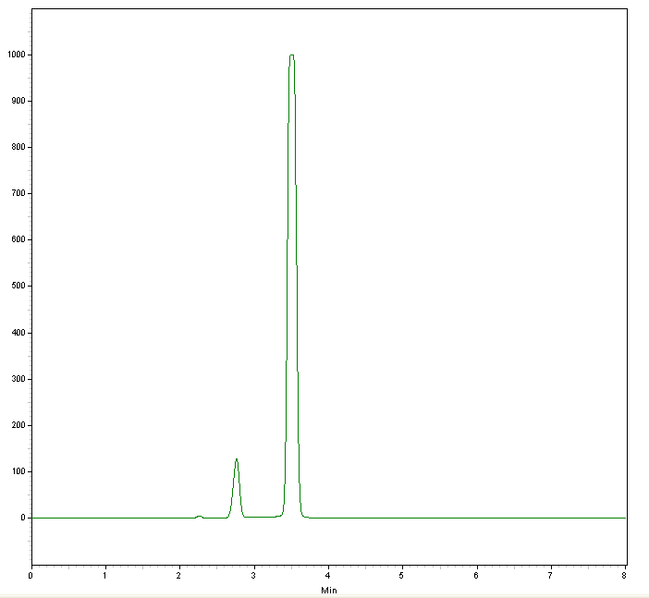
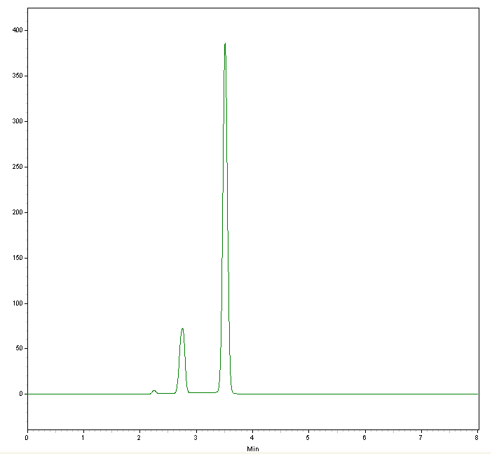
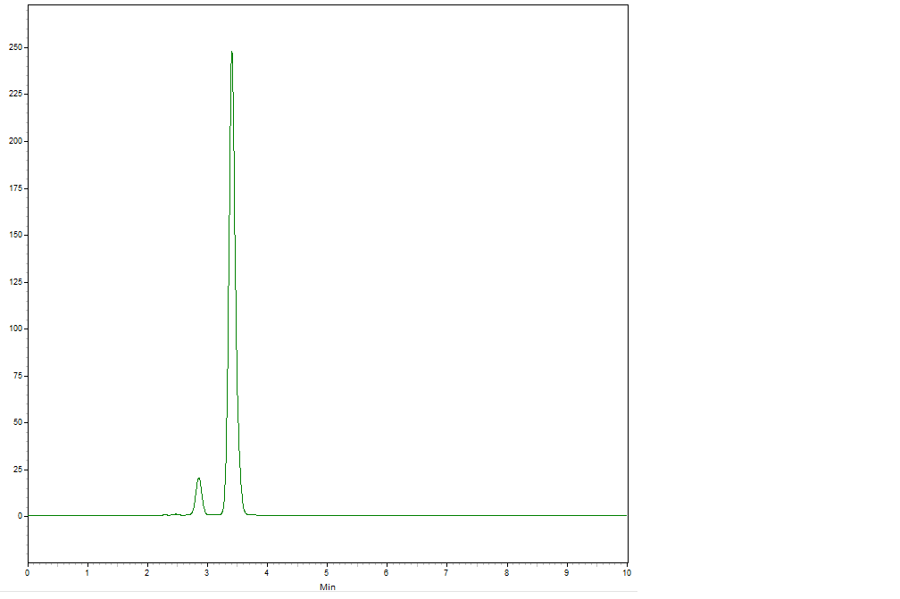
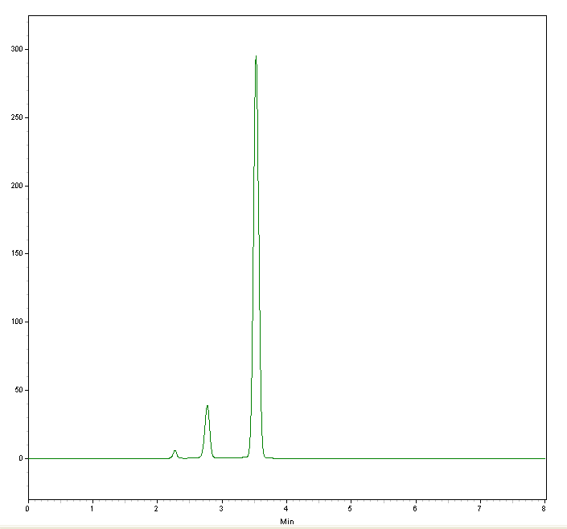
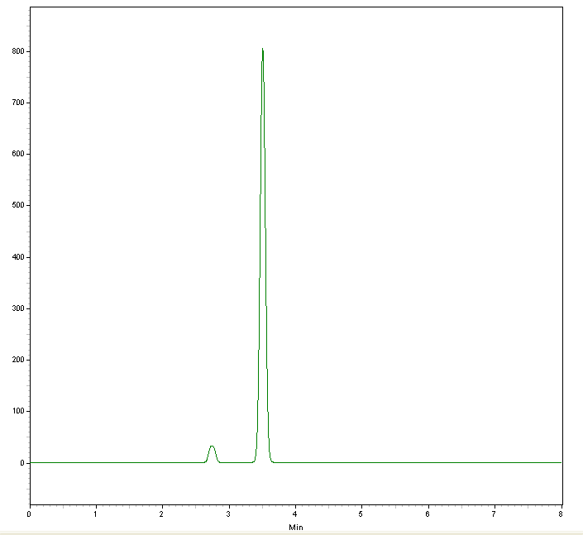
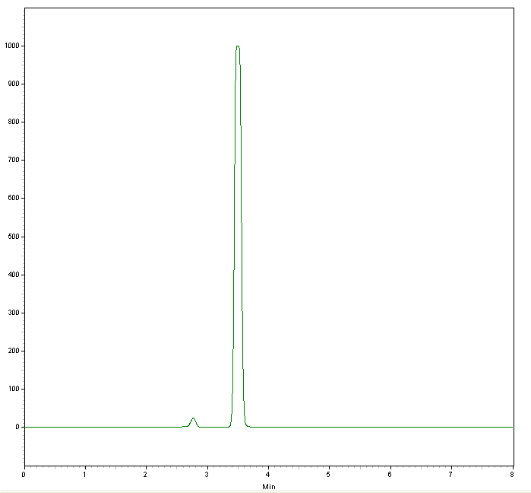
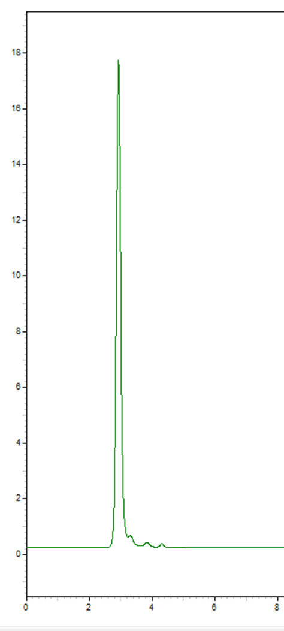
QUANTITATIVE CE-LIF AND LC-MS/MS METHODS FOR PHOSPHORYLATED P53 PEPTIDES
Eda Ates^{1, 2}, Oh-Seung Kwon³, Min-Jung Kang ^{1, 2*}
¹Center for Advanced Bio-Molecular Recognition, Korea Institute of Science and Technology, Seoul 02792, Republic of Korea.
²Division of Bio-medical Science and Technology, KIST School, Korea University of Science and Technology, Seoul 02792, Republic of Korea.
³Doping Control Center, Korea Institute of Science and Technology, Seoul 02792, Republic of Korea.
ABSTRACT
The tumor suppressor p53 protein plays an important role in regulating genes that control cell cycle arrest, apoptosis, and cell senescence. The phosphorylation of p53 protein remains low in normal cells and is activated via PTMs when cells encounter stressors. Therefore, finding a quantitative analysis method of PTM is useful for understanding the relationship between protein modification site, interacting enzymes which lead to cell senescence and cancer incidence. In this study, capillary electrophoresis-laser induced fluorescence (CE-LIF) and liquid chromatography-LTQ-Orbitrap mass spectrometry (LC-MS/MS) methods were developed for the quantitative analysis of phosphorylation p53 peptide at n-terminal. The method was validated using the synthetic substrate of p53 and its four phosphorylated peptides at 6, 9, 15, and 20 serine. The LOD and LOQ obtained from CE-LIF were as follows; 0.2 and 0.6 ng/mL (Pep1), 1.6 and 4.8 ng/mL (Pep2), 0.4 and 1.2 ng/mL (Pep3), 0.6 and 1.8 ng/mL (Pep4), 1.2 and 3.6 ng/mL (Pep5). Compared to CE-LIF method, LC-MS/MS method showed higher LOQ values; 27 ng/mL, 12 ng/mL, 18 ng/mL, 9 ng/mL, and 24 ng/mL, from Pep1 to Pep5 respectively. The reproducibility and accuracy of QC samples were within 9.5% and 94 ± 5.1% for CE-LIF and 12% and 99 ± 8.5% for LC-MS/MS, respectively. The developed methods were applied to quantitative analysis of target peptides in colon cancer cell line, HCT116, treated with different concentrations of doxorubicin. The results showed that decrease of non-phosphorylated p53 peptide and elevation of phosphorylated p53 peptides. Both methods gave low detection limit and wide quantitative ranges. However CE-LIF method surpasses LC-MS/MS method with its lower detection limit and less sample amount requirement. Therefore, CE-LIF has the potential for high throughput screening of phosphorylated p53 protein for discovery of therapeutic target and drug screening for anti-cancer therapy.
1. Peptide Sequence
METHODOLOGY
1. Method Optimization
RESULTS
Peptide Name | Peptide Sequence | Phosphorylation Site
Pep 1 | 5-FAM- MEEPQSDPSVEPPLSQETFSDLWK | Non-phosphorylated
Pep 2 | 5-FAM- MEEPQ-pS-DPSVEPPLSQETFSDLWK | Serine 6
Pep 3 | 5-FAM- MEEPQSDP-pS-VEPPLSQETFSDLWK | Serine 9
Pep 4 | 5-FAM- MEEPQSDPSVEPPL-pS-QETFSDLWK | Serine 15
Pep 5 | 5-FAM- MEEPQSDPSVEPPLSQETF-pS-DLWK | Serine 20
A.
B
100
Pep3
Pep1
50
Pep5
C
D
RFU
Pep2
Pep4
0
1
2
3
4
Time (min)
Table 5. p53 peptide method validation using CE-LIF
Figure 1. Electropherograms of peptide separation in different buffers. (A) 0.1 M Glycine / HCl (pH 3), (B) 0.1 M HEPES (pH 5), (C) Phosphate and (D) 0.1 M Borate (pH 9).
Buffer: 100 mM CAPS + 1 M Betaine (pH: 11) Capillary Length: 29 cm – Total length: 39.2
Capillary Temperature: 25 ºC Separation Voltage: +20 kV
Separation Duration: 8 min
2. CE-LIF
A
B
100
Pep1
All separations were carried out using a Beckman Coulter PA 800 ProteomLab equipped with a solid state laser induced fluorescence detector. The working length of uncoated capillary (i.d. of 50 µm) 39.2 cm in total length and the effective length was 29 cm.
50
The capillary was pre-conditioned with 1 M NaOH for 15 min, 1 M HCl for 15min, DW for 10 min and then BGE for 10 min using a pressure of 20 psi at the capillary inlet. The rinsing between two analyses was carried out with, 1M NaOH for 5 min, deionized water for 3 min, and finally the running BGE for 3 min using a pressure of 20 psi. A plug of sample was injected from the inlet end by applying a pressure of 0.5 psi for 10 s. The separation was carried out under +20 kV at 20°C and the samples were maintained at 4°C with the sample storage module. Data acquisition and instrument control were carried out using Karat 8.0 software.
C
D
100
Pep2
Non-phosphorylated peptide
Relative Abundance
Pep3
E
50
10
Time (min)
Pep4
Pep5
20
Phosphorylated peptides
Figure 3. Chromatograms of peptides in mobile phases: A: 0.1%FA in DW, B: 0.1%FA in ACN. (A) Pep1, (B) Pep2, (C) Pep3, (D) Pep4 and (E) Pep5.
Mobile Phase: A: 0.1%FA in DW, B: 0.1%FA in ACN Column: Accucore™ 150 C18 HPLC Columns
Separation Temperature: 28 ºC Separation Duration: 68 min
Figure 4. Chromatogram of peptide mixture in mobile phases: A: 0.1%FA in DW, B: 0.1%FA in ACN
3. Method Application
Buffer Name | pH | Concentration | Additive
Borate | 9, 9.5 | 20, 50, 70, 100 mM | -
CAPS | 10, 10.5, 11 | 20, 50, 70, 100 mM | 100, 400, 700, 1000 mM Betaine
Glycine / HCl | 3,3.5 | 100 mM | -
HEPES | 5,5.5 | 100 mM | -
Phosphate | 7,7.5 | 50, 100 mM | -
2. Method Validation
3.513
0 M Dox
Treated HCT116
3.506
10-9 M Dox
Treated HCT116
A | Pep1
 | Reproducibility (RSD, %) |  | Accuracy (%)
 | Interday | Intraday | Interday | Intraday
QC1 | 5.6 ± 2.4 | 4.4 ± 0.2 | 95.9 ± 2.3 | 93.7 ± 0.6
QC2 | 4.2 ± 1.9 | 3.4 ± 0.9 | 98.6 ± 3.5 | 95.2 ± 0.7
B | Pep2
 | Reproducibility (RSD, %) |  | Accuracy (%)
 | Interday | Intraday | Interday | Intraday
QC1 | 7.5 ± 1.7 | 2.7 ± 1.2 | 103.3 ± 4.8 | 100.1 ± 1.6
QC2 | 4.2 ± 3.8 | 3.5 ± 3.0 | 102.8 ± 6.0 | 99.7 ± 2.8
C | Pep3
 | Reproducibility (RSD, %) |  | Accuracy (%)
 | Interday | Intraday | Interday | Intraday
QC1 | 5.8 ± 2.4 | 3.1 ± 1.1 | 98.2 ± 4.9 | 96.0 ± 2.8
QC2 | 4.5 ± 3.0 | 2.0 ± 1.9 | 99.5 ± 1.5 | 99.7 ± 1.3
2.764
2.763
3. LC-MS/MS
D | Pep4
 | Reproducibility (RSD, %) |  | Accuracy (%)
 | Interday | Intraday | Interday | Intraday
QC1 | 3.9 ± 2.0 | 1.7 ± 0.7 | 97.3 ± 4.9 | 100.6 ± 1.7
QC2 | 5.1 ± 4.4 | 1.5 ± 0.6 | 98.3 ± 3.3 | 99.7 ± 1.5
E | Pep5
 | Reproducibility (RSD, %) |  | Accuracy (%)
 | Interday | Intraday | Interday | Intraday
QC1 | 3.8 ± 2.3 | 1.0 ± 0.5 | 97.3 ± 4.3 | 99.7 ± 1.8
QC2 | 2.8 ± 1.1 | 2.5 ± 0.7 | 103.8 ± 2.6 | 100.6 ± 1.4
Peptide Name | Migration Time (min) | LOD | LOQ | Correlation (R²) Value
Pep1 | 2.75 ± 0.11 | 0.2 ng/ml | 0.6 ng/ml | 0.9998
Pep2 | 2.81 ± 0.14 | 1.6 ng/ml | 4.8 ng/ml | 0.9973
Pep3 | 2.78 ± 0.18 | 0.4 ng/ml | 1.2 ng/ml | 0.9960
Pep4 | 2.85 ± 0.12 | 0.6 ng/ml | 1.8 ng/ml | 0.9951
Pep5 | 2.67 ± 0.17 | 1.2 ng/ml | 3.6 ng/ml | 0.9978
3.496
10-8 M Dox
Treated HCT116
3.513
10-7 M Dox
Treated HCT116
An Accela++ LC system (Thermofisher Scientific) coupled to an LTQ-Orbitrap Velos Pro instrument was used for sample introduction and separation. The chromatographic separation was performed on an Accucore™ C18 (5-µm, 2.1 mm × 150 mm column, Thermofisher scientific, USA). The mobile phases A and B were 100% water and 100% acetonitrile, containing 0.1% formic acid, respectively. Separation flow had linear gradient from 0% to 100% A for 15 min, for 25 min linear gradient from 60% to 20%, 0% for 20 min, then the column was allowed to equilibrate for 12 min 100% for 12 min leading to a total run time of 82 min. Mobile phase flow was 200 µL/min.
2.767
2.764
Table 4. p53 peptide method validation using CE-LIF
B | Pep2
 | Reproducibility (RSD, %) |  | Accuracy (%)
 | Interday | Intraday | Interday | Intraday
QC1 | 4.1 ± 1.0 | 1.2 ± 0.2 | 99.0 ± 4.0 | 103.3 ± 1.0
QC2 | 7.7 ± 6.3 | 1.8 ± 0.4 | 98.6 ± 8.5 | 102.8 ± 1.9
Table 5. p53 peptide method validation using CE-LIF
3.504
10-6 M Dox
Treated HCT116
3.510
10-5 M Dox
Treated HCT116
A | Pep1
 | Reproducibility (RSD, %) |  | Accuracy (%)
 | Inter day | Intra day | Inter Day | Intra day
QC1 | 3.8 ± 0.1 | 1.1 ± 0.5 | 100.2 ± 3.9 | 102.7 ± 1.4
QC2 | 4.8 ± 1.4 | 3.4 ± 1.3 | 97.3 ± 4.7 | 98.6 ± 3.4
C | Pep3
 | Reproducibility (RSD, %) |  | Accuracy (%)
 | Interday | Intraday | Interday | Intraday
QC1 | 4.9 ± 1.7 | 2.0 ± 1.2 | 99.8 ± 4.9 | 98.6 ± 1.9
QC2 | 4.2 ± 2.7 | 3.3 ± 2.6 | 99.6 ± 4.1 | 98.4 ± 3.2
Mobile Phase |  | Additive
A | B | -
DW | MeOH | 0.1% FA
DW | ACN | 0.1% FA
DW | DW + ACN | 0.5% Acetic Acid
DW | ACN | 5% DMSO + 0.1% FA
2.767
2.767
Peptide 1
3.504
5-FAM
D | Pep4
 | Reproducibility (RSD, %) |  | Accuracy (%)
 | Interday | Intraday | Interday | Intraday
QC1 | 2.9 ± 2.3 | 2.1 ± 1.5 | 98.3 ± 2.8 | 97.6 ± 1.7
QC2 | 8.7 ± 8.0 | 3.5 ± 2.8 | 100.8 ± 8.8 | 95.3 ± 3.3
E | Pep5
 | Reproducibility (RSD, %) |  | Accuracy (%)
 | Interday | Intraday | Interday | Intraday
QC1 | 2.4 ± 2.2 | 1.3 ± 1.0 | 98.7 ± 2.4 | 99.6 ± 1.3
QC2 | 4.9 ± 4.0 | 2.5 ± 1.6 | 108.1 ± 5.3 | 101.8 ± 2.6
Peptide Name | Migration Time (min) | LOD | LOQ | Correlation (R²) Value
Pep1 | 17.54 ± 0.14 | 9 ng/ml | 27 ng/ml | 0.9944
Pep2 | 17.74 ± 0.17 | 4 ng/ml | 12 ng/ml | 0.9948
Pep3 | 17.84 ± 0.14 | 6 ng/ml | 18ng/ml | 0.9957
Pep4 | 17.62 ± 0.16 | 3 ng/ml | 9 ng/ml | 0.9978
Pep5 | 18.08 ± 0.17 | 8 ng/ml | 24 ng/ml | 0.9966
2.764
Peptide 1
2.764
CONCLUSIONS
Table 6. p53 peptide method validation using LC-MS/MS.
Table 7. p53 peptide method validation using LC-MS/MS.
We have developed two methods using CE-LIF and LC-MS/MS to detect the phosphorylated p53 protein on Serine residues.
Non-phosphorylated p53 peptide was detected using the CE-LIF method however, phosphorylated p53 peptides were not detected.
Non-phosphorylated p53 was detected in HCT116 cell treated with 10⁻⁶ M doxorubicin by LC-MS.
Pep4 (Serine 15 phosphorylation) was detected in HCT116 cell treated with 10⁻⁵ M doxorubicin by LC-MS.
The application capacities of the methods should be tested after inducing p53 phosphorylation by activator in the further studies.
Figure 5. Electropherogram of doxorubicin treated HCT116 samples in 0.1 M CAPS + 1 M Betaine Buffer. Instrument Condition: Buffer: 100 mM CAPS + 1 M Betaine (pH: 11) Capillary Length: 29 cm – Total length: 39.2 Capillary Temperature: 25 ºC Separation Voltage: +20 kV Separation Duration: 8 min
100
18.10
TIC F: ITMS + c ESI Full ms2
Relative Abundance
21.60
1072.80@cid35.00
50
[295.00-2000.00] MS
0
18.10
100
15.87
TIC F: ITMS + c ESI SRM
50
13.84
ms2 1072.80@cid35.00
0
14.0
14.5
15.0
15.5
16.0
16.5
17.0
17.5
17.79
18.0
18.5
19.0
19.31
19.5
20.0
20.5
21.0
21.5
[765.20-766.20] MS
100
16.24
16.79
18.00
18.96
TIC F: ITMS + c ESI Full ms2
100
20.10
20.31
21.41
22.62
23.10
24.37
25.37
26.41
TIC F: ITMS + c ESI Full ms2
ITMS + c ESI Full ms2 1072.80@cid35.00 [295.00-2000.00]
Time (min)
20.10
21.41
22.62
1046.00@cid35.00
1046.00@cid35.00
1019.97
50
[285.00-2000.00] MS
50
[285.00-2000.00] MS
100
1051.83
0
16.30
17.20
18.13
0
19.47
80
100
15.03
19.26
TIC F: ITMS + c ESI Full ms2
100
19.92
23.36
24.47
25.22
25.88
TIC F: ITMS + c ESI Full ms2
60
20.33
21.85
22.71
1072.80@cid35.00
21.19
22.43
1072.80@cid35.00
Relative Abundance
987.93
1502.85
Relative Abundance
[295.00-2000.00] MS
Relative Abundance
[295.00-2000.00] MS
40
1056.91
1411.97
50
50
20
600.45
671.30
755.99
820.58
845.98
939.44
971.41
1072.83
1244.98
1298.86
1377.89
1572.12
1678.14
0
22.80
0
24.01
26.28
0
379.26
903.88
1091.86
1177.67
1559.21
100
21.39
21.77
TIC F: ITMS + c ESI SRM
100
TIC F: ITMS + c ESI SRM
500
1000
1500
2000
ms2 1046.00@cid35.00
ms2 1046.00@cid35.00
50
[774.20-775.20] MS
50
25.45
[774.20-775.20] MS
m/z
0
15.25
0
19.14
18.08
100
15.91
17.63
22.93
TIC F: ITMS + c ESI SRM
100
TIC F: ITMS + c ESI SRM
100
TIC F: ITMS + c ESI Full ms2
ms2 1072.80@cid35.00
20.18
ms2 1072.80@cid35.00
Relative Abundance
1072.80@cid35.00
REFERENCES
50
20.76
[765.20-766.20] MS
50
[765.20-766.20] MS
50
13.94
15.66
16.49
17.49
19.55
20.44
20.93
21.27
[295.00-2000.00] MS
0
15
16
17
18
19
20
21
22
23
0
19
20
21
22
23
24
25
26
27
0
18.06
Time (min)
Time (min)
100
TIC F: ITMS + c ESI SRM ms2
Courtney J, K., Lloyd, B., Lindsay M, V., Gayatri P, G, Patrick K, R, Ebenezer O, N, Lisa Ann, H., Challenging Bioanalyses with Capillary Electrophoresis, Analytical Chemistry, (2019).
Bode, A., Dong, Z. Post-translational modification of p53 in tumorigenesis. Nat Rev Cancer 4, 793–805 (2004).
3.Hafner, A., Bulyk, M.L., Jambhekar, A. et al. The multiple mechanisms that regulate p53 activity and cell fate. Nat Rev Mol Cell Biol 20, 199–210 (2019).
50
14.09
15.30
16.51
17.26
17.57
19.46
20.12
20.74
21.56
1072.80@cid35.00 [765.20-766.20]
0
14.0
14.5
15.0
15.5
16.0
16.5
17.0
17.5
18.0
18.5
19.0
19.5
20.0
20.5
21.0
21.5
ITMS + c ESI Full ms2 1072.80@cid35.00 [295.00-2000.00]
Time (min)
100
765.78
814.64
80
60
Relative Abundance
748.35
1020.90
40
794.67
1175.54
1588.80
1629.03
20
428.28
462.15
561.46
619.32
652.44
721.42
840.56
879.74
971.91
1011.96
1087.62
1168.20
1234.41
1320.75
1384.93
1441.70
1530.96
1569.80
1740.08
0
333.26
395.20
524.40
928.53
1642.22
1767.87
1833.34
1908.06
1943.29
1984.15
Acknowledgement
500
1000
m/z
1500
2000
This research was supported by the Korea Institute of Science and Technology institutional program (2E30480 and 20440)
Figure 5. Chromatogram of HCT 116 cell line treated with different concentration of doxorubicin.
Presenting author: Eda ATES eda.ates@kist.re.kr
Corresponding author: Min-Jung KANG mjkang1@kist.re.kr

